Slide 1
Perceptron and Multi-layer Perceptron(MLP)
Presented by:
Anish Pokharel
Menuka Lamsal
Reviewed by:
Rishikesh Sharma Poudel Hansika Jha
Rudra Nahawang Pandey Raju Yadav

Slide 2
Overview
1
Perceptron
Activation function
Types of Perceptron
Algorithm
Application
References
Code

Slide 3
Perceptron
2
Simplest linear artificial neural network(ANN)
Simple model biological neuron in ANN
Supervised learning algorithm for binary classifiers
Consists inputs, weights, bias term, output
Used to adjust weight of inputs
Minimizes difference desired and actual output

Slide 4
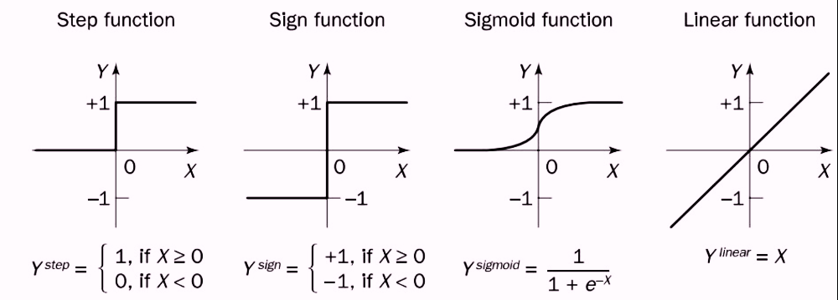
Activation function
3
Decides whether neuron activated or not.
Types of activation function:

Slide 5
Types of Perceptron
4
Based on layers, Two types:
1. Single-layer Perceptron
2. Multi-layer Perceptron

Slide 6
Single-layer Perceptron
5
One of the easiest ANN types
Consists feed-forward network
Includes threshold transfer function inside model
Analyze linearly separable objects
Algorithm do not contain recorded data
Begins with inconsistently allocated weight-input parameters

Slide 7
Single-layer Perceptron
6
Sums up all inputs(weights).
If sum > threshold, activated & output +1.
If outcome=threshold,
- performance stated as satisfied
- weight demand doesn’t change
For desired output, change weight input

Slide 8
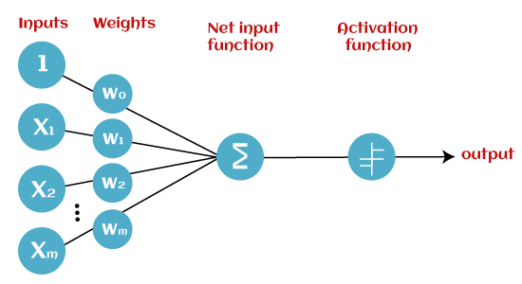

Single-layer Perceptron
7
Y=b +$\sum_{i=0}^{m}{xi∗wi }$,where
xi= inputs
wi= weights
b= bias,
used when w=0,x=0 to get y>0
Note: similar to linear regression/classification equation of y = m*x + c

Slide 9
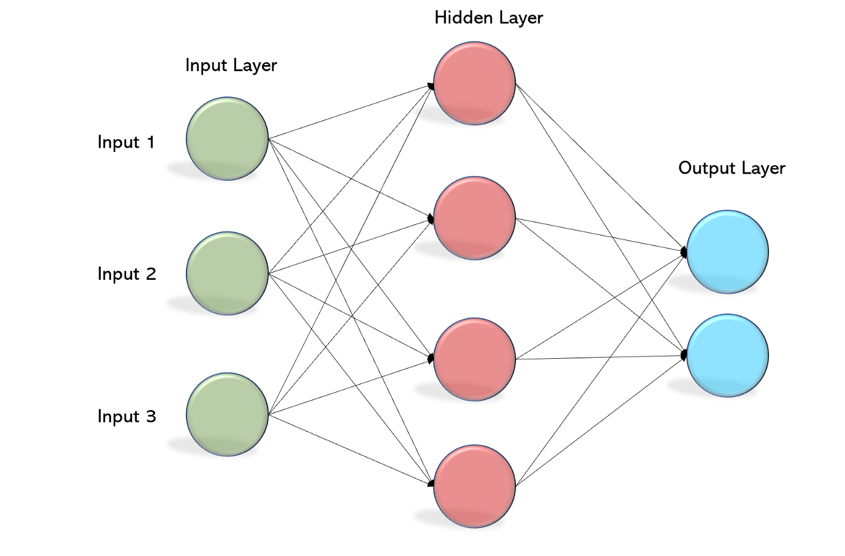
Multi-layer Perceptron
8
Like single-layer, have same model structure
Multiple artificial neural networks
Has one or more hidden layers
Known Backpropagation algorithm
Executes in two stages :
1. Forward Stage
2. Backward Stage

Slide 10
Multi-layer Perceptron
9
Forward Stage:
- Activation function start from input layer
- Terminate on the output layer
Backward Stage:
- weight, bias values modified as requirements
- error originated backward on output layer
- ended on the input layer

Slide 11
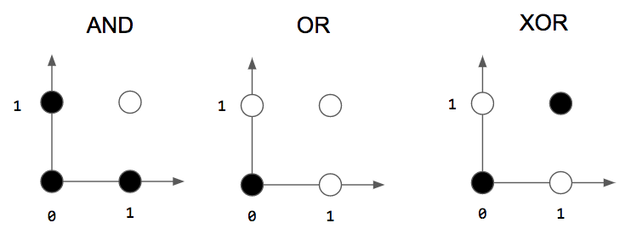
10
Let’s consider the logic gates in the figure above.
White output 1, black 0, axes inputs.
input 1, 1 AND gate, output 1, white.
create perceptron that acts like gates:
-they take 2 binary inputs
-produce a single binary output
Linear not for XOR, so Multiple.

Slide 12
Perceptron(Algorithm):
11
It is trained using labeled dataset.
Initialize weights, biases small random values.
For each sample in the dataset:
Compute output current sample using weights, biases.
Calculate error for the current sample.
Update weights, biases using update rule.
Repeat 2&3 until error below threshold.

Slide 13
Application
12
Speech Recognition
Image Recognition
Machine Translation
And so on.

Slide 14
References:
13
https://www.javatpoint.com/perceptron-in-machine-learning
https://becominghuman.ai/multi-layer-perceptron-mlp-models-on-real-world-banking-data-f6dd3d7e998f

Slide 15
Code
14

Slide 16
Thank you
15

